Slide 1
Database Access
Presented By:
Vaishali Gupta

Slide 2
INDEX
INTRODUCTION 3 ROWID and RECID 17
Database Connection 4 Record Relation 19
Database Functions 5 JOINS 20
Alias 6 Word Break Table and Word Index 22
Database Handling Statements 7 CONTAINS 23
Adding and Deleting Records 9 SEQUENCE 24
Fetching Records 10 RAW Datatype 26
Database Index 13 Database Triggers 28
BY, BREAK BY, USE-INDEX 14 Schema and Session Trigger 29
Aggregate phrase and ACCUMULATE statement 15 Schema Triggers 31
Query and Result List 16 Session Triggers 33

Slide 3
Introduction
Database is an electronic filing system for organizing and storing data that relates to a broad subject area, like sales and inventory.
A database that lets you organize data so you can easily define and exploit relationships among data is called a relational database.
Database is made up of tables. A table is a collection of records about a specific subject, like customers.
A record is a collection of pieces of information, called fields, about one thing, like a single customer.
A field is a specific item of information, like a customer name.
An index uses data from a field or fields as the basis for searching, sorting, or otherwise processing records.
The Data Dictionary lets you define and create databases.

Slide 4
Database Connection
CONNECT Statement establishes a connection to one or more databases
A single procedure cannot connect to and then access a database.
The CONNECTED function tests whether a database is connected
Connect all application databases only once at application startup to reduce the number of connects and disconnects to minimize overhead if there are plenty of available connections.

Slide 5
Database Functions
DO x = 1 TO NUM-DBS WITH DOWN: //Number of connected databases.
DISPLAY PDBNAME(x) LABEL "Physical Database"
LDBNAME(x) LABEL "Logical Name"
DBTYPE(x) LABEL "Database Type"
DBRESTRICTIONS(x) LABEL "Restrictions"
SDBNAME(LDBNAME(x)) LABEL "Schema Holder DB".
END.

Slide 6
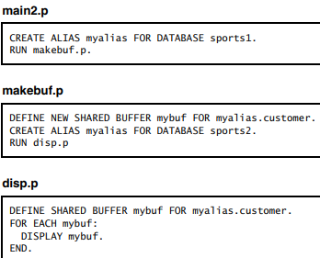
Alias
Alias
When want to use different logical
database name
You cannot assign and reference an alias
in the same procedure.
Run-time error results if you reference
a shared buffer after changing the alias that initially was used in defining it.

Slide 7
Database Handling Statements
PROMPT-FOR : User -> Screen Buffer
ASSIGN : Screen Buffer -> Record Buffer
SET : User -> Screen buffer -> Record buffer (PROMPT-FOR + ASSIGN)
DISPLAY : Record Buffer -> Screen Buffer
UPDATE : Record Buffer -> Screen Buffer -> Record buffer (DISPLAY + SET)
FIND : Db Record -> Record Buffer
FOR-EACH : Db Record -> Record Buffer

Slide 8
Database Handling Statements
ENABLE: User -> Screen Buffer (Input is enabled with the ENABLE statement and blocked with the WAIT–FOR statement)
CREATE : Database Record -> Record Buffer
INSERT : Database Record -> Record Buffer->Screen buffer, User -> Screen buffer -> Record buffer
OPEN-QUERY : Database Record -> Record Buffer -> Screen Buffer
GET : Db Record -> Record Buffer
RELEASE : Record Buffer -> Database Record.

Slide 9
Adding and Deleting Records
CREATE statement creates a record in a table, sets all the fields in the record to their default initial values, and moves a copy of the record to the record buffer.
CREATE statement places a newly created record in the database but does not display the record or request user input.
INSERT statement not only creates the record, but also displays the record and requests input.
INSERT= CREATE, DISPLAY, PROMPT–FOR and ASSIGN statements
INSERT= CREATE+ UPDATE
DELETE: Removes a record from a record buffer and from the database.

Slide 10
Fetching Records
FIND : Locates a single record in a table and moves that record into a record buffer.
FOR-EACH: Starts an iterating block, finding a single record on each iteration. If you do not use the EACH keyword, the Record phrase you use must identify exactly one record in the table.
OPEN QUERY - Opens a query, which might have been previously defined in a DEFINE QUERY statement. Opening a query makes it available for use within a GET statement, or in a browse widget.
DO PRESELECT and REPEAT PRESELECT
PRESELECT creates a temporary index that contains pointers to each of the preselected records in the database table. Then you can use other statements, such as FIND NEXT, within the block to process those records

Slide 11
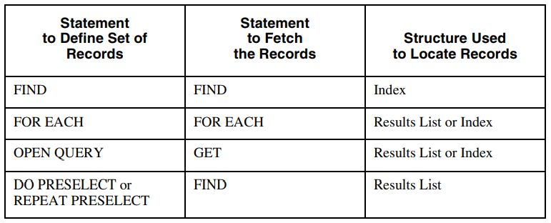
Progress fetches records depends in part on which statements you use to fetch the records
The FOR EACH statement, OPEN QUERY statement, and PRESELECT option may use multiple indexes to satisfy a query. When multiple indexes are used, the order of returned records is not guaranteed.

Slide 12
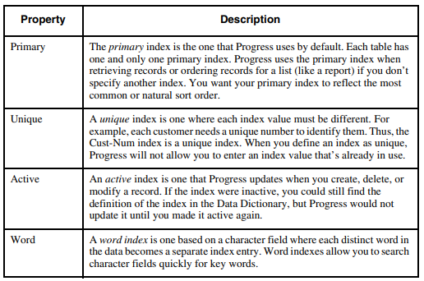
Database INDEX

Slide 13
BY, BREAK BY, USE-INDEX
BY Sorts the selected records by the value of expression.
The DESCENDING option sorts the records in descending order (not in the default ascending order).
BREAK : You use the BREAK option to define field as the break group
When used in combination with the FIRST function, LAST function, FIRST-OF function, and LAST-OF function, BREAK indicates that subgroups are used for aggregation. If you use BREAK, you must also use BY.
USE-INDEX : Identifies the index you want to use while selecting records.

Slide 14
Aggregate phrase and ACCUMULATE statement
BY break-group Performs aggregation for break groups if you use the BREAK option in a FOR EACH block header
Identifies one or more values to calculate based on a change in an expression or a break group.
{ AVERAGE | COUNT | MAXIMUM | MINIMUM | TOTAL | SUB-AVERAGE | SUB-COUNT | SUB-MAXIMUM | SUB-MINIMUM | SUB-TOTAL }... [ LABEL aggr-label] [ BY break-group].
ACCUMULATE statement Calculates one or more aggregate values of an expression during the iterations of a block. Use the ACCUM function to access the result of this accumulation.
ACCUMULATE { expression ( aggregate-phrase ) }

Slide 15
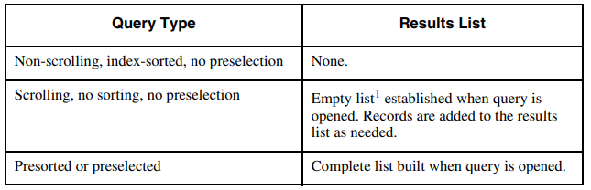
Result List
A query is a request for database data that results in one or more records.
A results or results list is the record or set of records defined by a query.

Slide 16
Navigating a Results List
You can use the REPOSITION statement to specify how many places forward or backward you want to move, so that you can skip over a given number records. It also allows you to move to a specific ROWID.
GET NEXT gets the next record, and GET PREV gets the previous record
After a REPOSITION, the position is always between two records
REPOSITION FORWARD 1 repositions the results list between the next record and the record after it.

Slide 17
ROWID and RECID
Progress provides a function named after the ROWID data type to return ROWID values.
You cannot store ROWID values in database or temporary tables, but you can store their hexadecimal string representations using the STRING function.
You can then retrieve the string as a ROWID value using the TO–ROWID function
You cannot return a ROWID for a view because view records do not have unique identifiers.

Slide 18
ROW ID vs REC ID
ROW ID
REC ID
A "row id" is a row identifier that uniquely identifies that row (or data record) in a database.
Supported by all Database servers
Row ID uses Absolute Address.
It does not use Index.
RECID is supported in this recent version of Progress for backward compatibility.
Supported by few Database servers.
REC ID uses Relative Address
It uses Indexes.

Slide 19
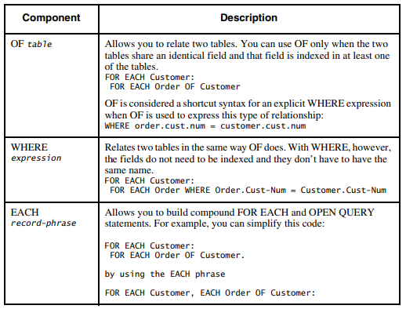
Record Relation

Slide 20
JOINS
Inner join — Supported in all statements capable of reading multiple tables, including the FOR, DO, REPEAT, and OPEN QUERY statements.
Progress does not return that value or a result for the results list if a value in the left table does not have a corresponding value in the right table
[ LEFT ] OUTER-JOIN
Specifies a left outer join between record and the table (or join) specified by the previous Record phrase(s) of an OPEN QUERY statement.
Progress returns the left-table value with an unknown value (?) from the right table.

Slide 21
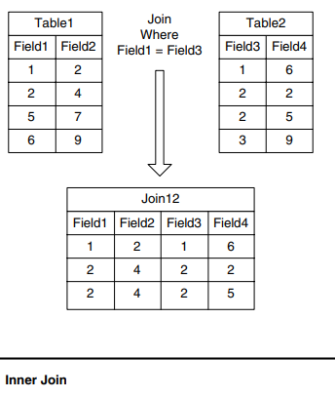
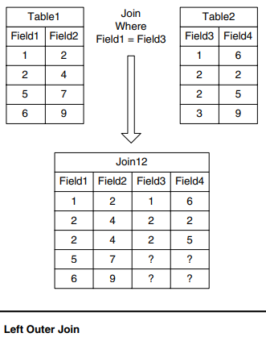

Slide 22
Word Break Table and Word Index
Progress examines the contents of the field, breaks it down into individual words, and, for each individual word, creates or modifies a word index.
To break down the contents of a field into individual words, Progress must know which characters act as word delimiters. To get this information, Progress consults the database’s word-break table, which lists characters and describes the word-delimiting properties of each.

Slide 23
CONTAINS
field CONTAINS search-expression
"word[[ & | | | ! | ^ ]word]..."
Each word is a word to search for. The ampersand (&) represents a logical AND; the vertical line (|), exclamation point (!), or caret (^) represent a logical OR. You can use an asterisk (*) as a wildcard, but only at the end of a word. Using an asterisk anywhere else in a word raises an error.
The CONTAINS option is not allowed in a FIND statement
Work Break Table must be there in order to use CONTAINS.

Slide 24
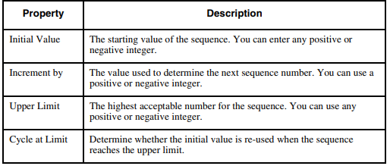
SEQUENCE
Sequences can generate sequential values within any integer range with either positive or negative increments.

Slide 25
Three types of sequences:
Nonterminating Sequence — A sequence that begins at an initial value and increments in one direction with no limit.
Terminating Sequence — A sequence that begins at an initial value and increments in one direction until it reaches a designated limit.
Cycling Sequence — A sequence that begins at an initial value and increments in one direction until it reaches a designated limit.
Use the NEXT–VALUE function to increment a sequence by its defined positive or negative increment value. If the sequence cycles and NEXT–VALUE increments it beyond its Upper or Lower limit, the function sets and returns the defined Initial value for the sequence. If the sequence terminates and NEXT–VALUE tries to increment it beyond its Upper or Lower limit, the function returns the unknown value (?) and leaves the sequence value unchanged.
Use the CURRENT–VALUE statement to explicitly set a sequence to a new value. You can assign the defined initial value of a sequence, its upper or lower limit, or any integer value in between.

Slide 26
Raw Datatype
You can use the RAW data type to import non–Progress data that has no parallel Progress data type.
By using the RAW data type statements and functions, Progress allows you to bring data from any field into your procedure, manipulate it, and write it back to the non-Progress database.
The functions and statements let you define RAW data type variables, write data into a raw variable, find the integer value of a byte, change the length of a raw variable, and perform logical operations.

Slide 27
Database Triggers

Slide 28
Database Triggers
A database trigger is a block of 4GL code that executes whenever a specific database event occurs. A database event is an action performed against a database.
The database events that Progress supports, along with the standard triggers and replication-related triggers are:
CREATE : Fire trigger when Progress executes a CREATE or INSERT statement for a table.
DELETE : Fire trigger when Progress executes a DELETE.
FIND : When Read a record in table using a FIND or GET statement or a FOR EACH loop.
FIND triggers do not fire in response to the CAN–FIND function.
WRITE : When Progress changes the contents of a record and validates it for a database table
ASSIGN : When Progress updates a field in a database record

Slide 29
Schema and Session Triggers
Schema triggers
Session triggers
Schema triggers are independent procedures
Schema triggers always execute when a specified event occurs, regardless of what application initiates the event.
Since schema triggers are compiled separately from the procedure that initiates their execution, they do not have access to the procedure’s frames, widgets, and variables.
Session triggers are contained within a larger procedure
Session triggers are defined as part of an application and are only in effect for that application
Session triggers have access to the procedure’s frames, widgets, and variables.

Slide 30
Schema and Session Triggers
Schema Triggers
Session Triggers
Use schema triggers for processing that you always want to perform for a specific event.
For example, when an order record is deleted, you may always want to delete the corresponding order-line records.
Use session triggers to perform additional or independent processing when the event occurs.

Slide 31
Schema Trigger
Trigger definition is stored in a trigger procedure.
TRIGGER PROCEDURE FOR { FIND | CREATE | DELETE | REPLICATION-CREATE | REPLICATION-DELETE } OF table
TRIGGER PROCEDURE FOR { WRITE | REPLICATION-WRITE } OF table [ NEW [ BUFFER ] buffer-name1 ] [ OLD [ BUFFER ] buffer-name2 ]
The NEW buffer contains the modified record that is being validated. The OLD buffer contains the most recent version of the record before the latest set of changes were made
You can modify the contents of the NEW buffer, but the OLD buffer is read-only. You can compare the contents of these two buffers and perform actions based on the results

Slide 32
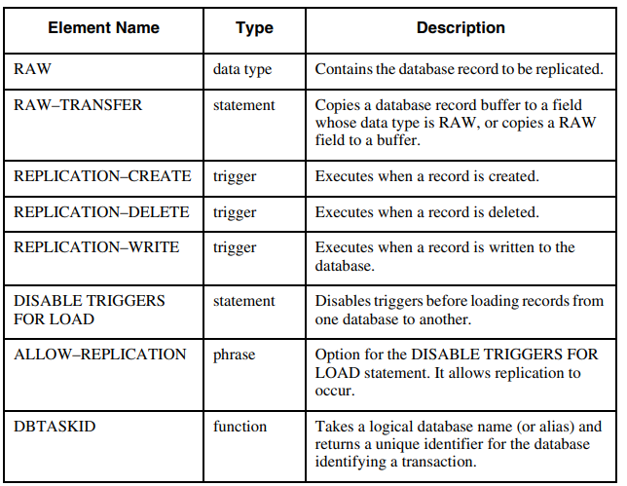

Slide 33
Session Triggers
You define a database session trigger within a Progress procedure.
A session trigger takes effect when Progress encounters it at run time. It remains in effect until the defining procedure terminates.
ON event OF object [ reference-clause ] [ OVERRIDE ] { trigger-block | REVERT }
event : The event parameter is a CREATE, WRITE, DELETE, FIND, or ASSIGN event.
object The object for table-related events (CREATE, DELETE, FIND, or WRITE) has this syntax: OF table
The object-reference for a field-related event (ASSIGN) has this syntax: OF table.field
reference-clause The reference-clause for a table related event (WRITE triggers only) has this syntax:
[ NEW [ BUFFER ] buffer1 ] [ OLD [ BUFFER ] buffer2 ]

Slide 34
OVERRIDE: The OVERRIDE option causes the session trigger to execute instead of the schema trigger, if the schema trigger is defined with OVERRIDE=YES. If you attempt to OVERRIDE a schema trigger defined as OVERRIDE=NO, Progress returns a runtime error.
trigger-block: A single 4GL statement or a DO block. The trigger block executes whenever the specified event occurs. In fact, this code executes when the event occurs, almost as if it were an internal procedure.
REVERT: The REVERT option cancels the trigger for the given event/table or event/field pair and reactivates any previously defined trigger for that event/object pair defined in a parent procedure. If no previously defined trigger exists, the trigger for the event/object pair is effectively disabled.

Slide 35
Observations
create trigger is fired after the customer record is created.
Delete trigger is fired when delete statement executed, firing time - trigger is executed before deletion of customer. If validation of delete trigger fails, record is not deleted.
Assign trigger is executed on table.field not on tables while write trigger is executed on table record.
write trigger is executed before writing the record to the database so, we can do validations in write trigger block,if validation succeeds, record is written to database otherwise returns error.
write trigger is executed when record is released, or end of procedure statement.
whenever asssign trigger is executed , after that write trigger is also executed.
"FIND triggers do not fire in response to the CAN-FIND function." However, when CAN-FIND is used with a ROWID in the query, then the FIND database trigger is still fired.

Slide 36
Observations
Find trigger does not execute if find statement does not satisfy the full search condition i.e. where clause.
All the session trigger executes before schema trigger but in case of find trigger, schema trigger executes before session trigger.
There are no session triggers related to database replication.
There is no replication-assign trigger.
Replication triggers execute after schema trigger.
only find trigger executes on the statement of "disable triggers for load of customer", All session and schema triggers get disabled for that table for load option.
only Find Trigger does not execute on the statement of "disable triggers for dump of customer".

Slide 37
Thank You

